Slide 1
EI1EL2
Electronics 2
Audio Amplifier Design - Introduction
Dr Ian Phillips
Notes:
Connect an audio amplifier and show on working.
Kick-off individual project which is designing an audio amplifier
Here’s one I made earlier.

Slide 2
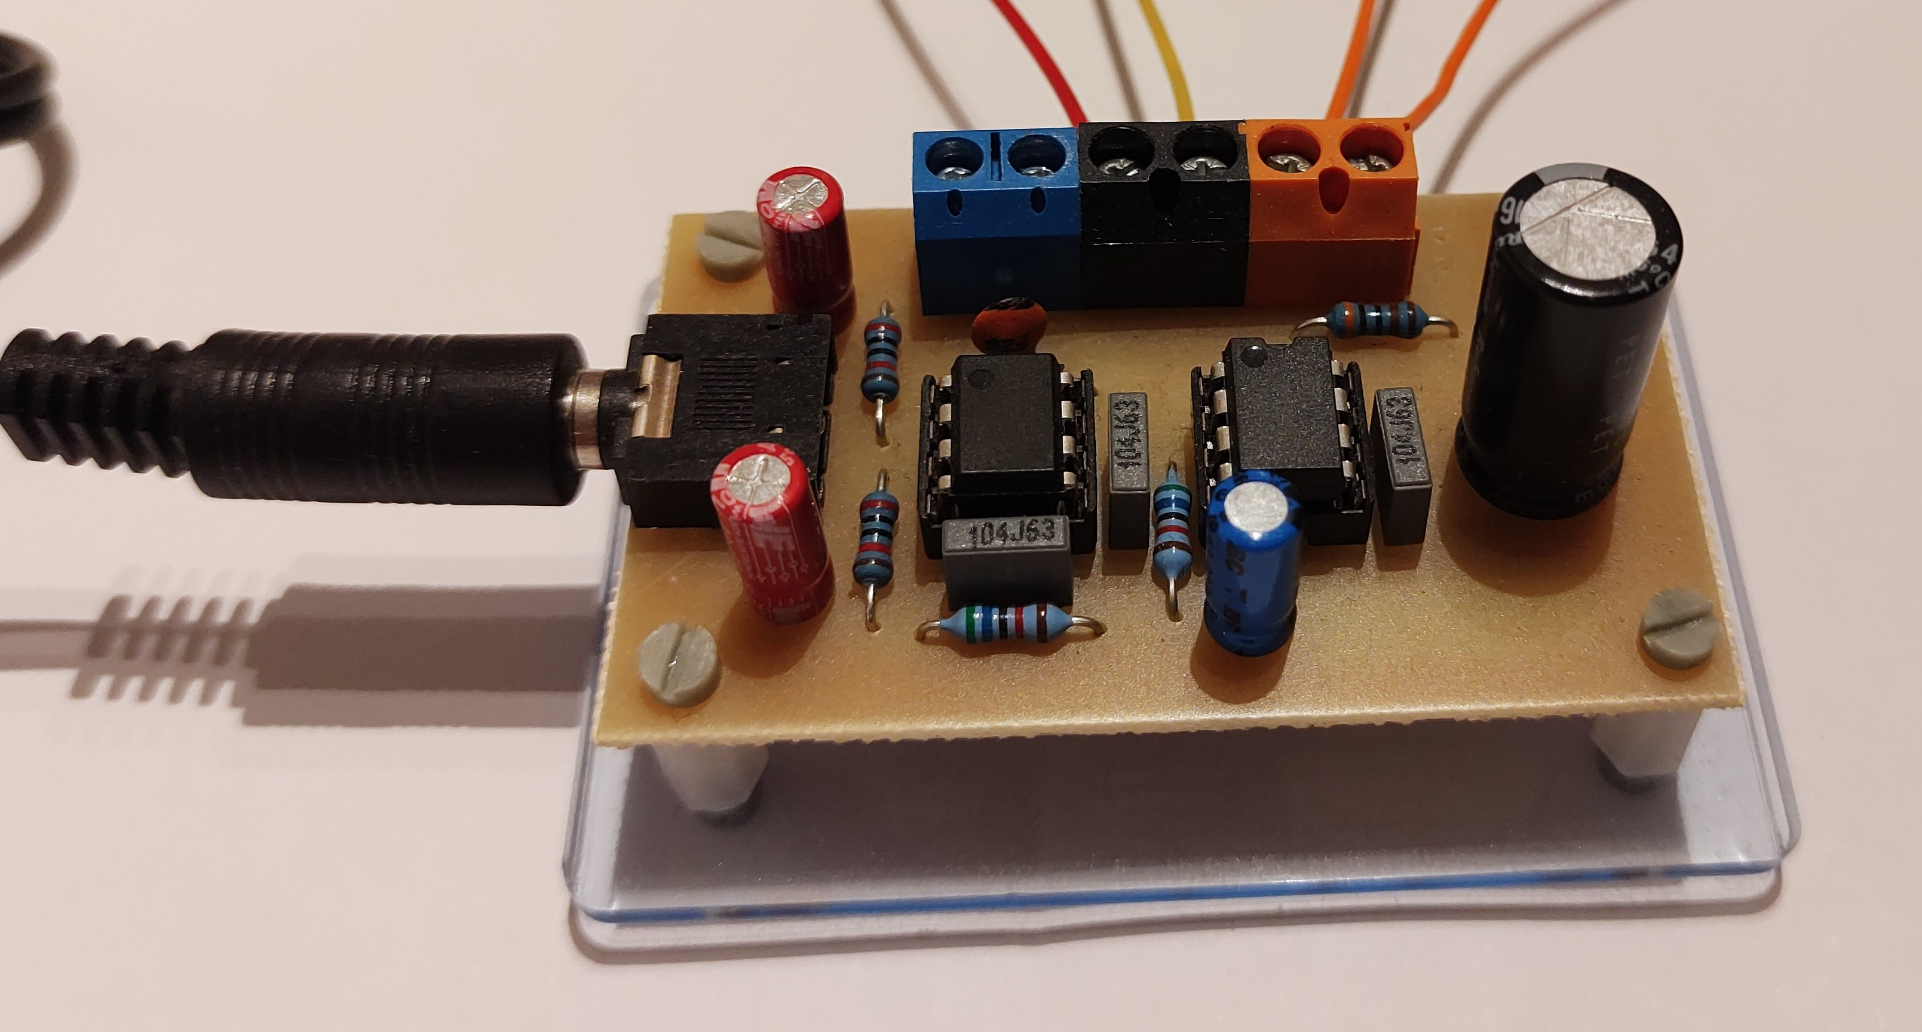
Your Task
Design and build a two-stage audio amplifier with a filter that takes a signal from a mobile phone or MP3 player and amplifies it to drive an external speaker
Why two-stage?
A more complex problem
Connecting output of TL071 filter directly to a speaker would sound very bad due to limited current supply
A buffer amplifier is required
Notes:
The reason we will make a two-stage amplifier (apart from making the design more interesting for you), is we will use the TL071 voltage amplifier as the pre-amplifier input.
If you connect this directly to a speaker, then it sounds terrible.
Reason, it can’t provide enough current.
Buffer amplifier beefs up current to drive speakers.

Slide 3

Detailed Design
Everybody should come up with there own design
We will recognise two designs the same and you will be penalised for plagiarism
Talk to each other, that’s encouraged
You will start with slightly different values
Converge to a very similar design
We don’t won’t the exactly same design
???
Notes:
Everybody should come up with there own design.
Two designs the same, and we will split your mark. DO YOU OWN DESIGN. Easy to spot.
Talk to each other, that’s ok.
You will start with slightly different values.
Converge to a very similar design
We don’t won’t the exactly same design.

Slide 4
Why are we doing this???
“I expect placement students an graduates to have a good understanding of analogue electronics… e.g. op-amps and transistors” Rolls Royce
“I expect students to be able to find their own way around a lab and use equipment like function generators and oscilloscopes” UTC Aerospace
“Students need to be able to record what they have done so that we can use that information at a later date’ IBM
“I look for interns who are interested in how things work and can build up their own projects” Mattel
Notes:
Some comments from Employers
Employers want:
Hands on experience
start with basic brief and go through process of developing something and testing it
Use key equipment
Record what you are doing
Placement student leave after 12 months and hand over to new students
Interest in electronics. A lot of universities will have students watching lectures and know details of lots of op-amp circuits, but won’t be able to build one.
They are much more interested in people building something. You can look the circuits up.

Slide 5
Objectives and Learning Outcomes
When you have finished this project you should be able to:
  Plan the development of a simple prototype
  Use Proteus software to design and simulate a circuit and layout a PCB
  Demonstrate build and test skills for a simple circuit
  Understand the design and workings of an audio amplifier
  Write a concise but comprehensive design and test report

Slide 6
Assessment
A written technical design report (70% of module)
  Detailed template provided
  15 page limit

Slide 7
Top-level system or block diagram
Controls?
Power?
Controls?
Amplifier
Inputs?
Outputs?
Casing
Notes:
System diagram
What goes around the amplifier
Inputs from your phone (Left and right stereo signal)
What Controls?
Volume (possibly, but included on phone)
Treble/Bass (could be included)
On/off switch
Outputs
What comes out?
We won’t worry about Stereo, we will just use mono.
Most speakers are 8ohms, if different you will need to take this into account
Casing
Think about this at the start. Important to include mounting holes in design.
Could use prototype mounting box that have slots the pcb can fit into, but need to be correct size.

Slide 8
Gain
Power to IC 9V
Voltage out
(to speaker)
Voltage in
(from MP3)
Amplifier
From OPA551 datasheet
Ipk+/- 200mA continuous output
Iav ~ +/-250mA
Output resistance 8 Ohm
Power requirement = +/-3V from limits
Voltage out
(to speaker)
Gain =
Voltage in
(from Mobile)
Limited by
OPA551
current
TL071
Voltage gain
OPA551
Current
3
=
Voltage in
(See specification)
Notes:
This is your amplifier, it has two stages
TL071 which gives voltage gain
OPA551 which gives current gain
Voltage in from MP3
Power in to IC (9V)
Voltage out to speaker.
You will have a Gain
Set by amplifiers
Limited +/- 3V from supply rails
Total amount of current from OPA551

Slide 9
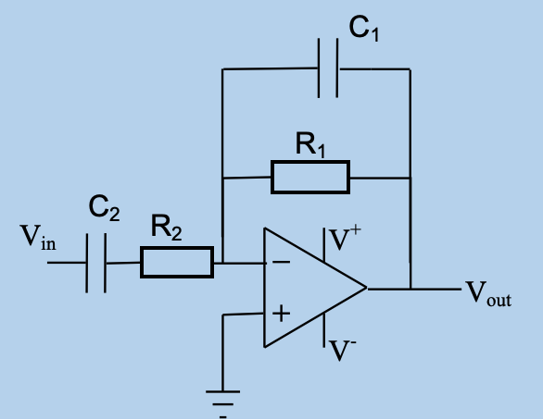
Active Bandpass filter
Upper cut-off frequency
f_{u} = 1/(2πR₁C₁)
Lower cut-off frequency
f_{l} = 1/(2πR₂C₂)
Gain= Vout = R₁
Vin R₂
Vout = 3, Vin = 0.7*Mb_max
Notes:
These slides should be familiar (EE1FUN)
Lower cut-off approx. 5-15Hz and upper cut-off 25-45kHz
Flat gain (voltage gain 3 to 30dB)
Remember which capacitors and resisters correspond to which cut-off frequency

Slide 10
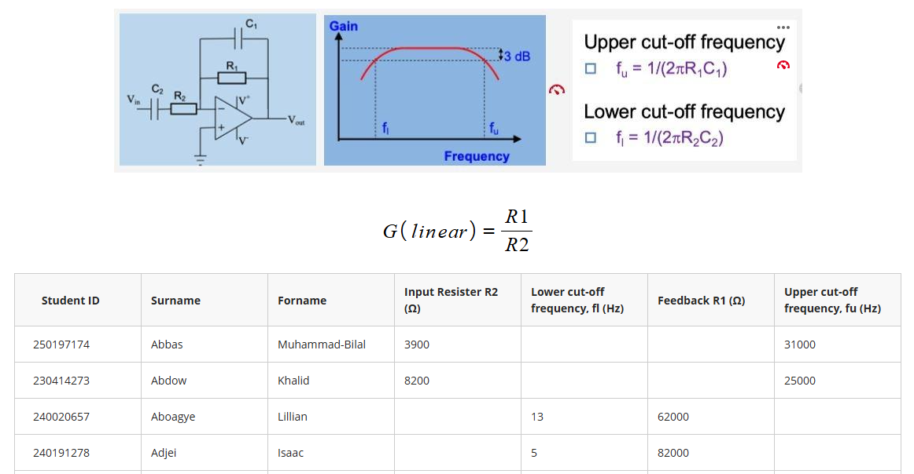
Design start points
Notes:
Some starting points on blackboard
Column for:
Input resister in kohms
Low-pass filter in kHz (high-side)
Feedback resister in kohms
High-pass filter in Hz (Low side)
We have given everybody two of the four parameters.
This is how we guarantee that you have slightly different designs
This is what I will be marking against.

Slide 11
Design start points
Each student has been given two of four parameters
  This table is located on blackboard
Ensures unique design
  Used to guarantee individual assessment
Using formula in Slides 10 you can calculate other values
Choose the other Cut-off frequency from the following limits:
  Lower: 5-15Hz
  Upper: 22 to 46 kHz
Notes:
Some starting points on blackboard
Column for:
Input resister in kohms
Low-pass filter in kHz (high-side)
Feedback resister in kohms
High-pass filter in Hz (Low side)
We have given everybody two of the four parameters.
This is how we guarantee that you have slightly different designs
This is what I will be marking against.

Slide 12
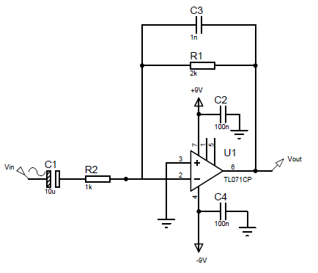
Power-Supply Decoupling
You might think that the +/-9V supply is fixed and stable, but the supply voltage can vary a little (particularly when drawing high current).
This can cause feedback, and in some circumstances cause very loud oscillations on the output.
We fix this issue by using power supply decoupling, where we add a 100nF capacitor to each power supply pin. The other end of the capacitor goes to 0V.
When you design a PCB, this capacitor must be connected to the IC pin with the shortest possible track.
Notes:
The decoupling capacitors need to be replicated every time you have an op-amp chip. (capacitor on pin 7)
Really can tell the difference
When you breadboard your circuit, build initially without decoupling capacitors and then add the capacitors and compare the sound quality.
Capacitors should be as close to pin 7 and ground as possible.
Track needs to be as short as possible.

Slide 13
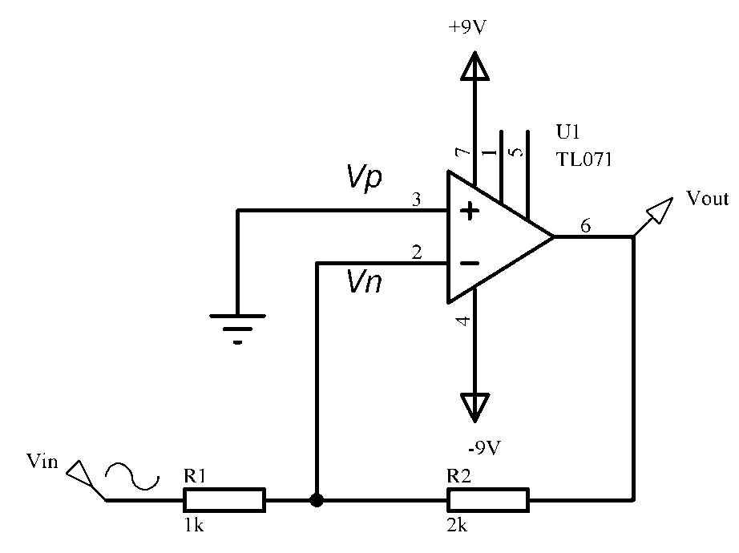
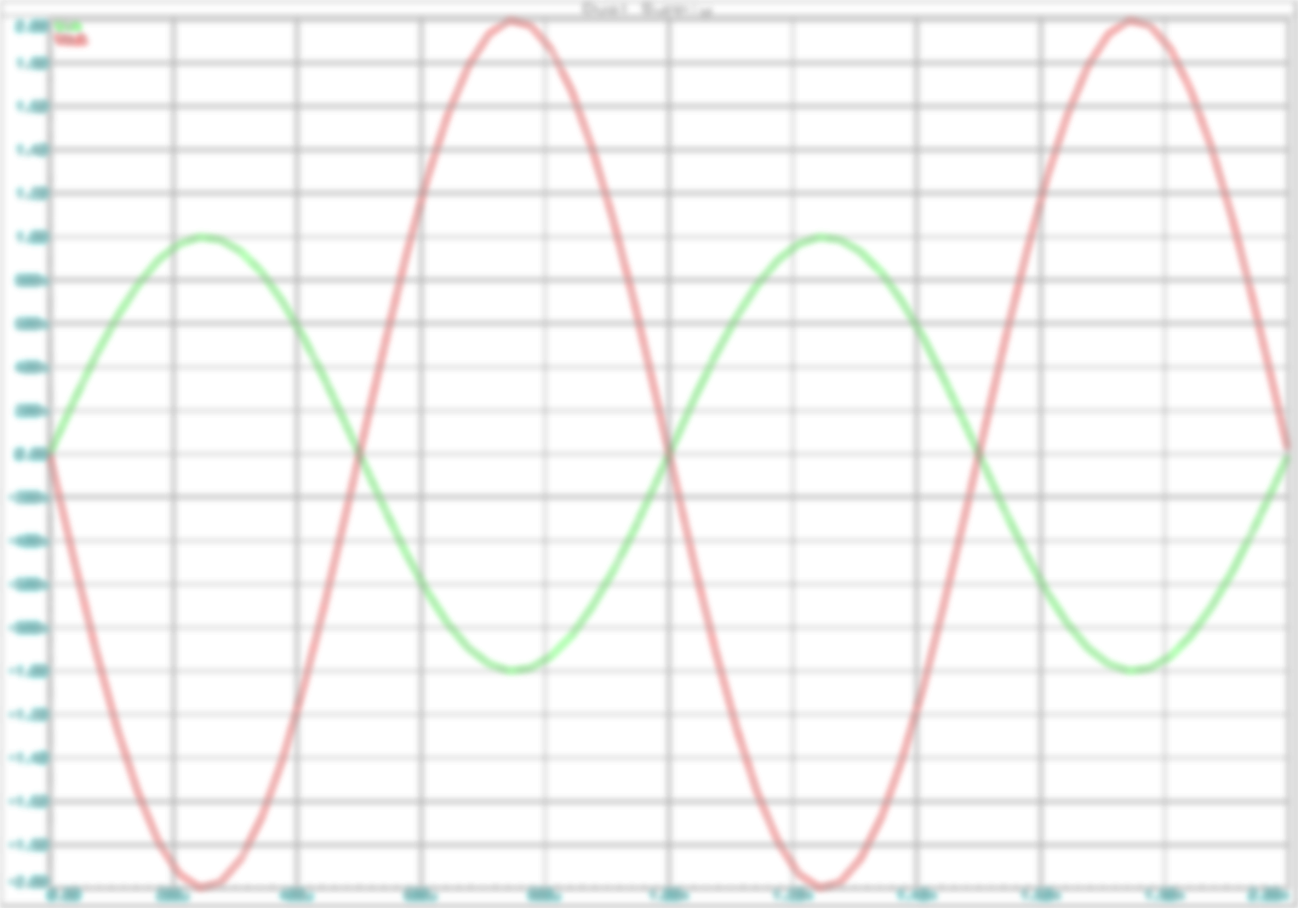
Single power supply operation
Up until now, we have used +/- 15V to power the amplifier
The amplifier output will therefore go equally positive and negative
Approximately +/-13 V for the TL071 with +/-15 supply
It is not always convenient to have a +/- dual supply, e.g. battery-powered circuit
There is a separate lecture that outlines single power supply operation next week

Slide 14
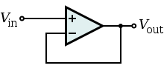
Voltage buffer – Current Amplifier
Unity Gain buffer amplifier, voltage gain = 1, provides significant current gain
High input impedance
  Does not load down source, draws minimal current
Low output impedance
  Drives load like perfect voltage source
OPA551 Provides the current to drive the speaker (8 ohm)
The Power supply (not shown in figure) will also need decoupling
Notes:
That’s the TL071 and then you go into a voltage buffer.
No gain, it is going to give an output voltage with a higher current capability.
----------------
A unity gain buffer amplifier may be constructed by applying a full series negative feedback (Fig. 2) to an op-amp simply by connecting its output to its inverting input, and connecting the signal source to the non-inverting input (Fig. 3). Unity gain here implies a voltage gain of one (i.e. 0 dB), but significant current gain is expected. In this configuration, the entire output voltage (β = 1 in Fig. 2) is fed back into the inverting input. The difference between the non-inverting input voltage and the inverting input voltage is amplified by the op-amp. This connection forces the op-amp to adjust its output voltage simply equal to the input voltage (Vout follows Vin so the circuit is named op-amp voltage follower).
The importance of this circuit does not come from any change in voltage, but from the input and output impedances of the op-amp. The input impedance of the op-amp is very high (1 MΩ to 10 TΩ), meaning that the input of the op-amp does not load down the source and draws only minimal current from it. Because the output impedance of the op-amp is very low, it drives the load as if it were a perfect voltage source. Both the connections to and from the buffer are therefore bridging connections, which reduce power consumption in the source, distortion from overloading, crosstalk and other electromagnetic interference.

Slide 15
Stereo input – mono amplifier
Phone
socket
R_{f}
- +
R_{i}
R_{i}
Bias
Summing amplifier
(Storey, 16.4.4)
Notes:
Be aware we have a phone socket.
It has left and right inputs.
Mono amplifier need to combine these inputs, capacitor and resister one for left and one for the right.
Doesn’t make a difference to gain
Can read more by reading textbook

Slide 16
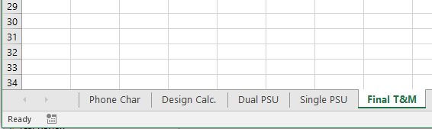
USE EXCEL
I expect EVERYBODY to use EXCEL
  This is a key tool and makes your life easier
Use Tabs, and have a different tab for each measurement stage

Slide 17
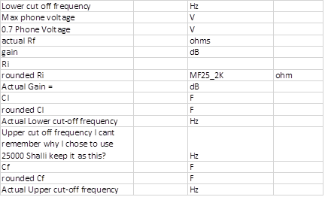
USE EXCEL
Design Calculation using EXCEL
  Don’t use your calculator or lab book

Slide 18
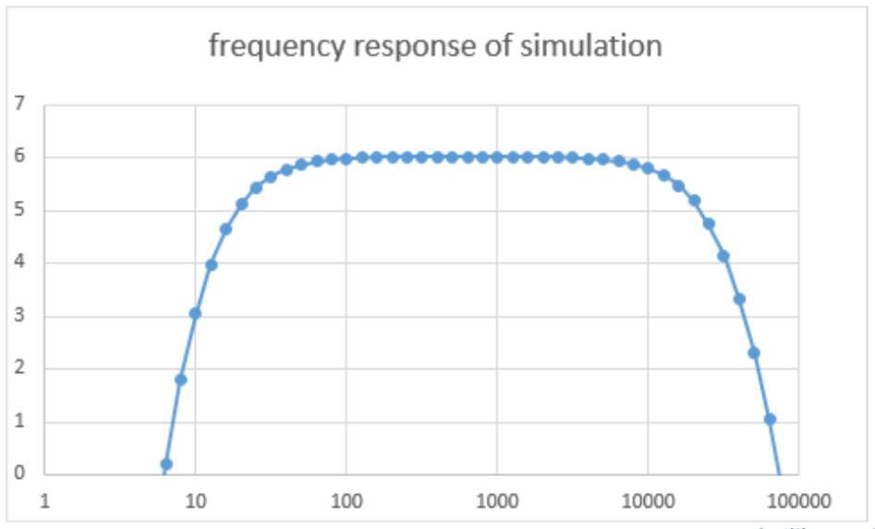
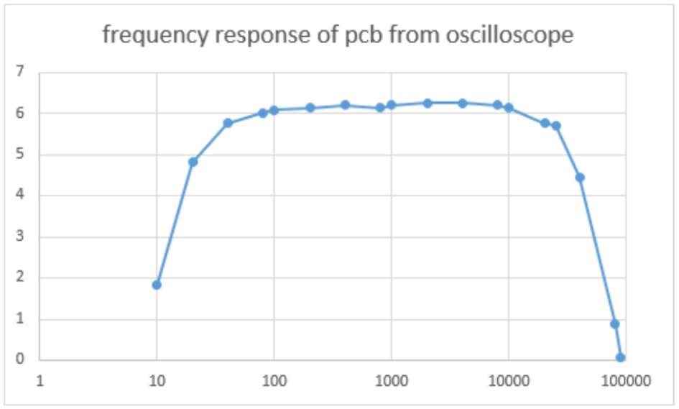
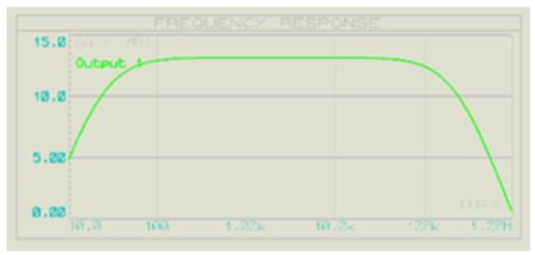
Plotting Graphs - Incorrectly

Slide 19
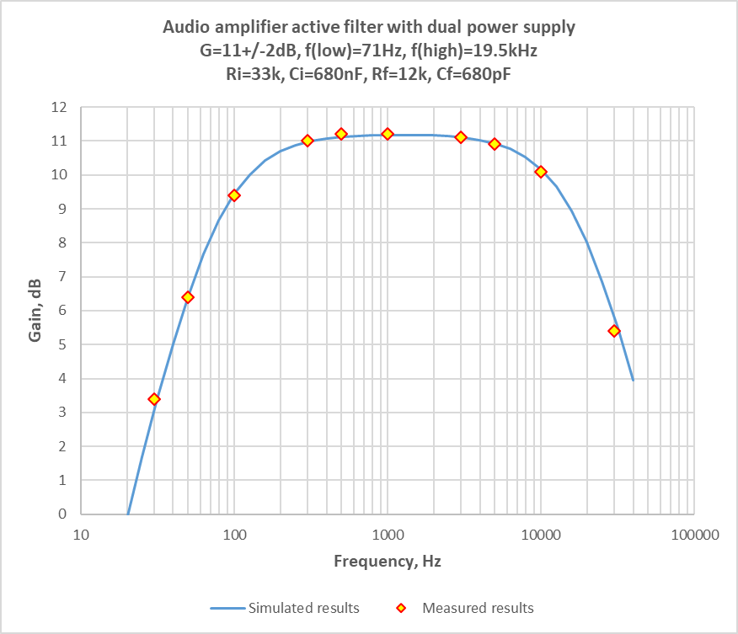
Plotting Graphs - Correctly

Slide 20
What next?
Ensure that you can access Proteus from your home PC
  Download and install locally
  AstonApps
  Aston VDI system

Slide 21
What voltage gain do I require?
Measure the output voltage from your mobile phone
  Open the 440Hz sinewave on your phone
  Connect your phone to the oscilloscope using appropriate connector
  Measure Vpp vs. volume setting (remember maximize signal on oscilloscope display)
  Plot in Excel. Vpp vs. volume setting (see next slide)

Slide 22
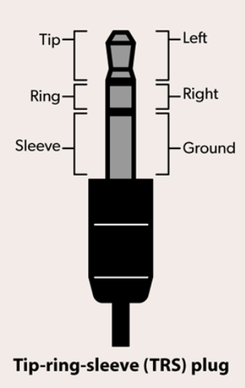
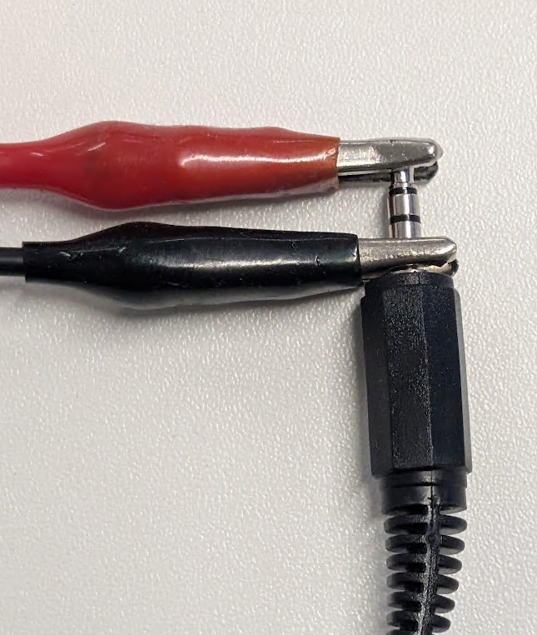
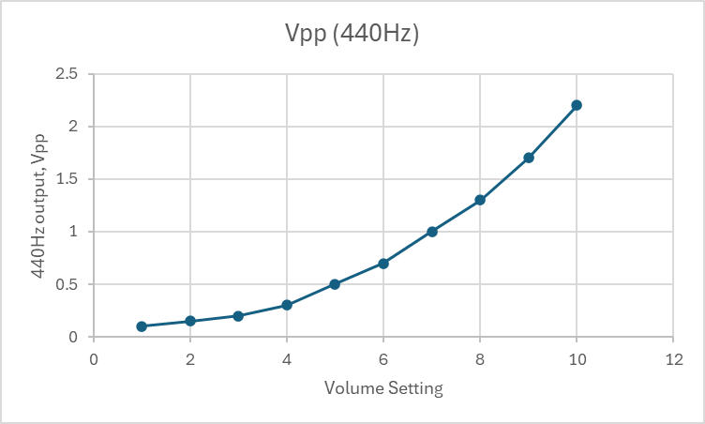
3.5mm Audio Output

Slide 23
What voltage gain do I require?
Calculate Target gain
  Assume input voltage = Mobile Phone max out * 0.7
  Assume output voltage = 3V_{pp}.
    This is limited by the OPA551 Power amplifier (see datasheet)
    OPA551 worst case specification is you need to operate 3Volts from each supply rail.
Calculate missing resister value
  R1 or R2 depending which you were given
Recalculate gain with available resister
  Find nearest available resister
  Calculate the actual gain

Slide 24
Active filter design
You now know R1, R2, and Actual Gain, G
You were given one cut-off frequency, either F_{low} or F_{high}
Choose the other Cut-off frequency from the following limits:
  Lower: 5-15Hz
  Upper: 22 to 46 kHz
Calculate C₁ and C₂ using the formula
Select the closest capacitor available
Recalculate actual F_{low} and F_{high}
Upper cut-off frequency
f_{u} = 1/(2πR₁C₁)
Lower cut-off frequency
f_{l} = 1/(2πR₂C₂)

Slide 25
Schedule

Slide 26
Progress tracking and Sign-off
This is your first individual project - it will need you to plan your time
To help us track your progress and provide support if needed, we will sign you off after each of the following stages:
  Mobile Phone characterization
  Design calculations
  Simulation using dual power supply
  Breadboard using a dual power supply
  Simulation using a single power supply
  Breadboard using a single power supply
  Final Schematic check
  Final PCB Check
  PCB Soldering Check
  Final Test and Measurement
  Final Audio Check using Speaker

Slide 27
Don’t forget!
Read the project brief document
Look at the report template
  Complete this on a weekly basis

Slide 28
EI1EL2
Electronics 2
Introduction

Slide 29

Any Questions?

